Slide 1
NETFLIX DATA AALYSIS
TEAM : 2010030490-VARUN KRISHNA
2010030468-SATHWIK
2010030494-SHASHIKANTH
2010030463-ANIL KUMAR

Slide 2

OUTLINE
ABSTRACT
FLOWCHART
GITHUB COMMITS
WORK PROGRESS
ALPHA TESTING
REFERENCES

Slide 3
ABSTRACT
The key to this project is to enhance the value of the Data being utilized, in our case it is Netflix Data – which is an Open-Source Data Set obtained from Kaggle – that was wrangled and exercised to derive maximum insights using EDA – Exploratory Data Analysis and Sentiment Analysis after the amalgamation of two additional sets – Geographical Latitudes & Longitudes and Netflix Title Critics/Reviews Data Set. The project is made using different utility analytical tools present in Python Library of versatile packages. This project introduces systematic and insightful usage of methods for Exploratory Data Analysis & Sentiment Analysis by utilizing various packages concerned

Slide 4
FLOW CHART

Slide 5
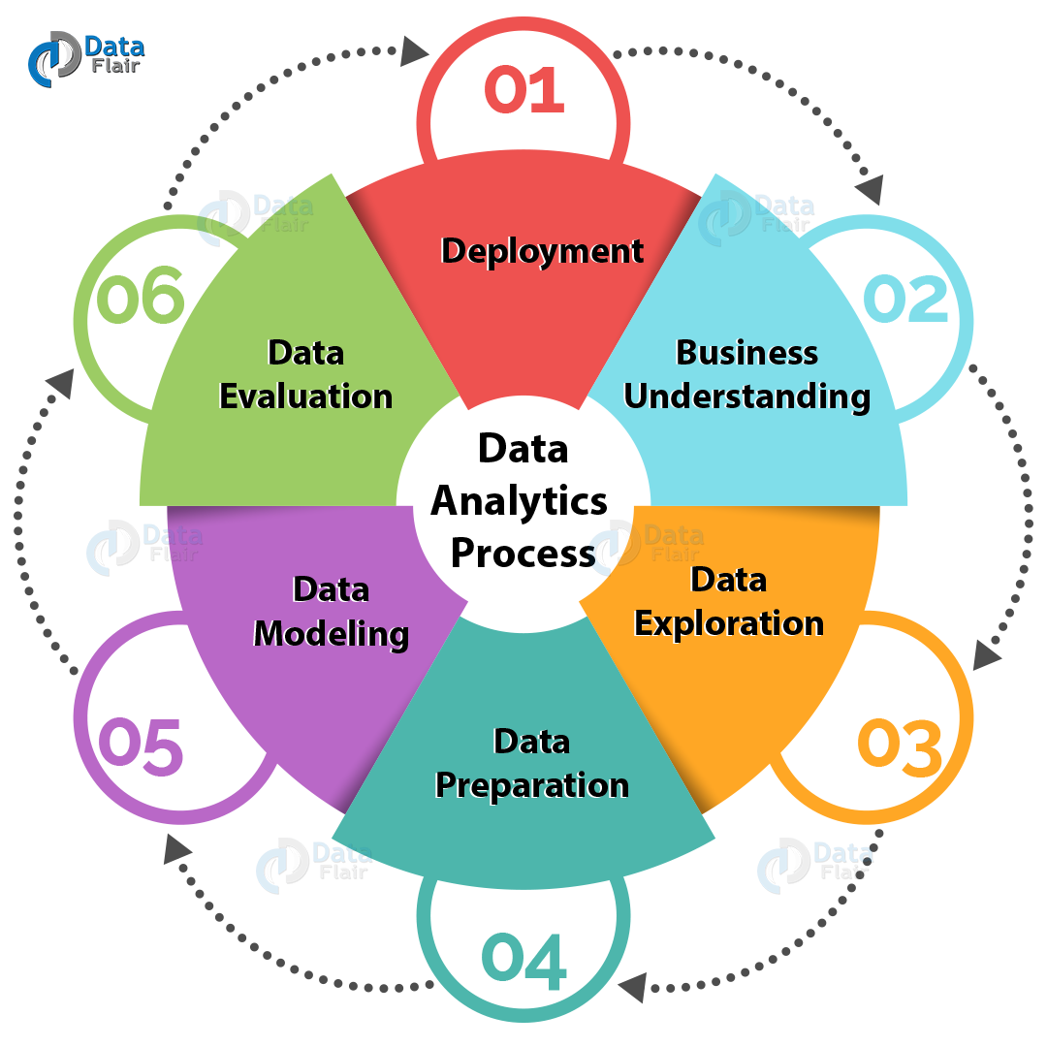
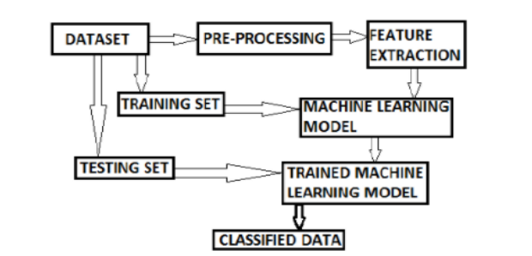

Slide 6
DATA PRE-PROCESSING
AND CLEANING
NETFLIX DATA
SET
LOAD YOUR DATA
ANALYZING THE DATA
DOWNLOAD the dataset familiar with the dataset
analyzing our data using Python and in google co-lab
Here we will try to remove the unnecessary cells or columns .
DATA VISUALIZATION
We try to visualize the data in the form of graphs,pie chart.stacked column charts etc..

Slide 7
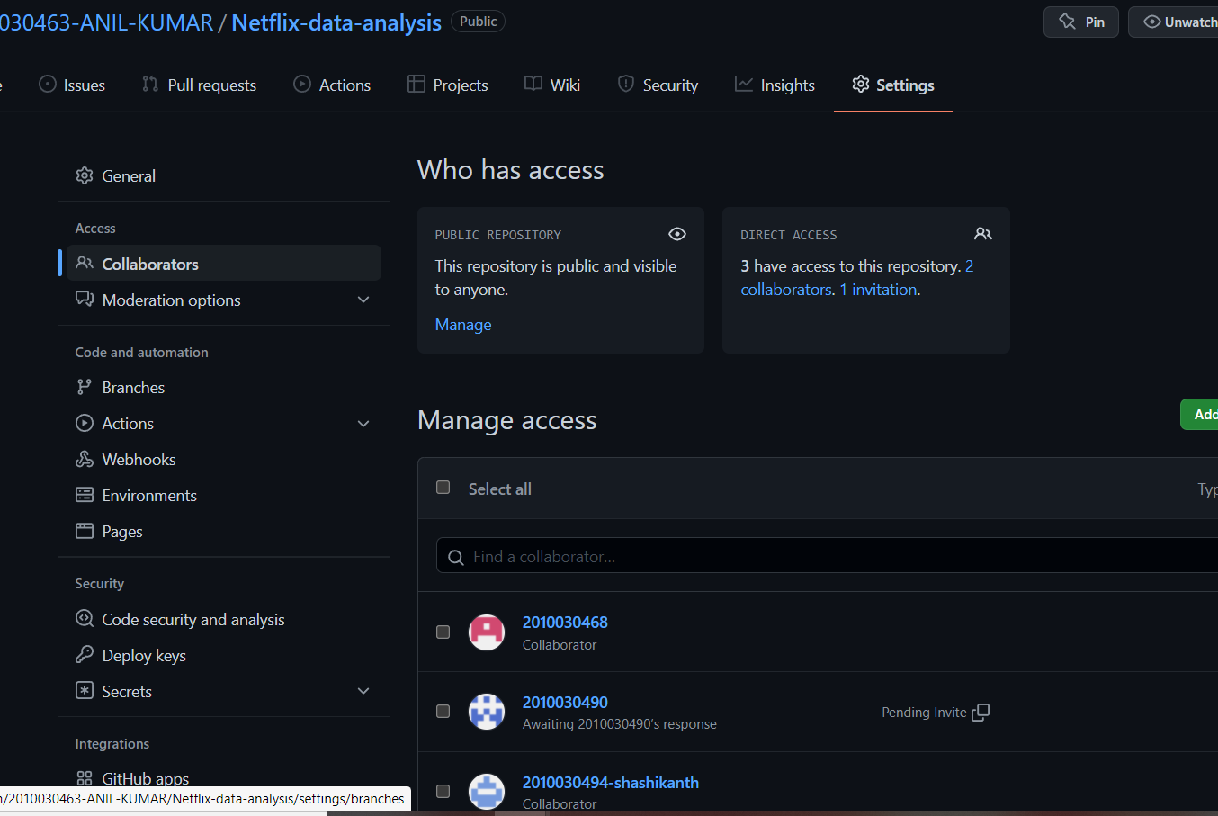
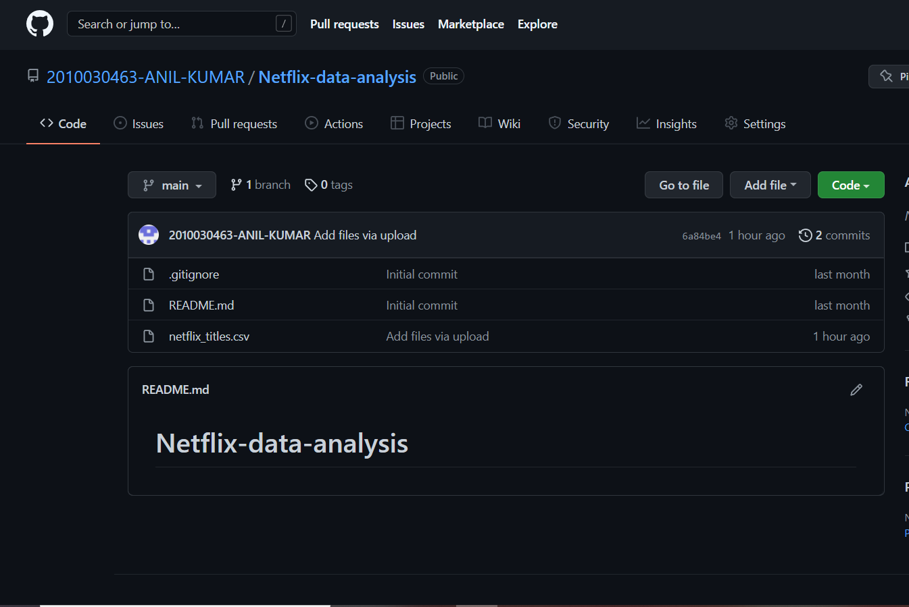
GITHUB COMMITS
REPOSITORY LINK :2010030463-ANIL-KUMAR/Netflix-data-analysis (github.com)

Slide 8
WORK PROGRESS

Slide 9
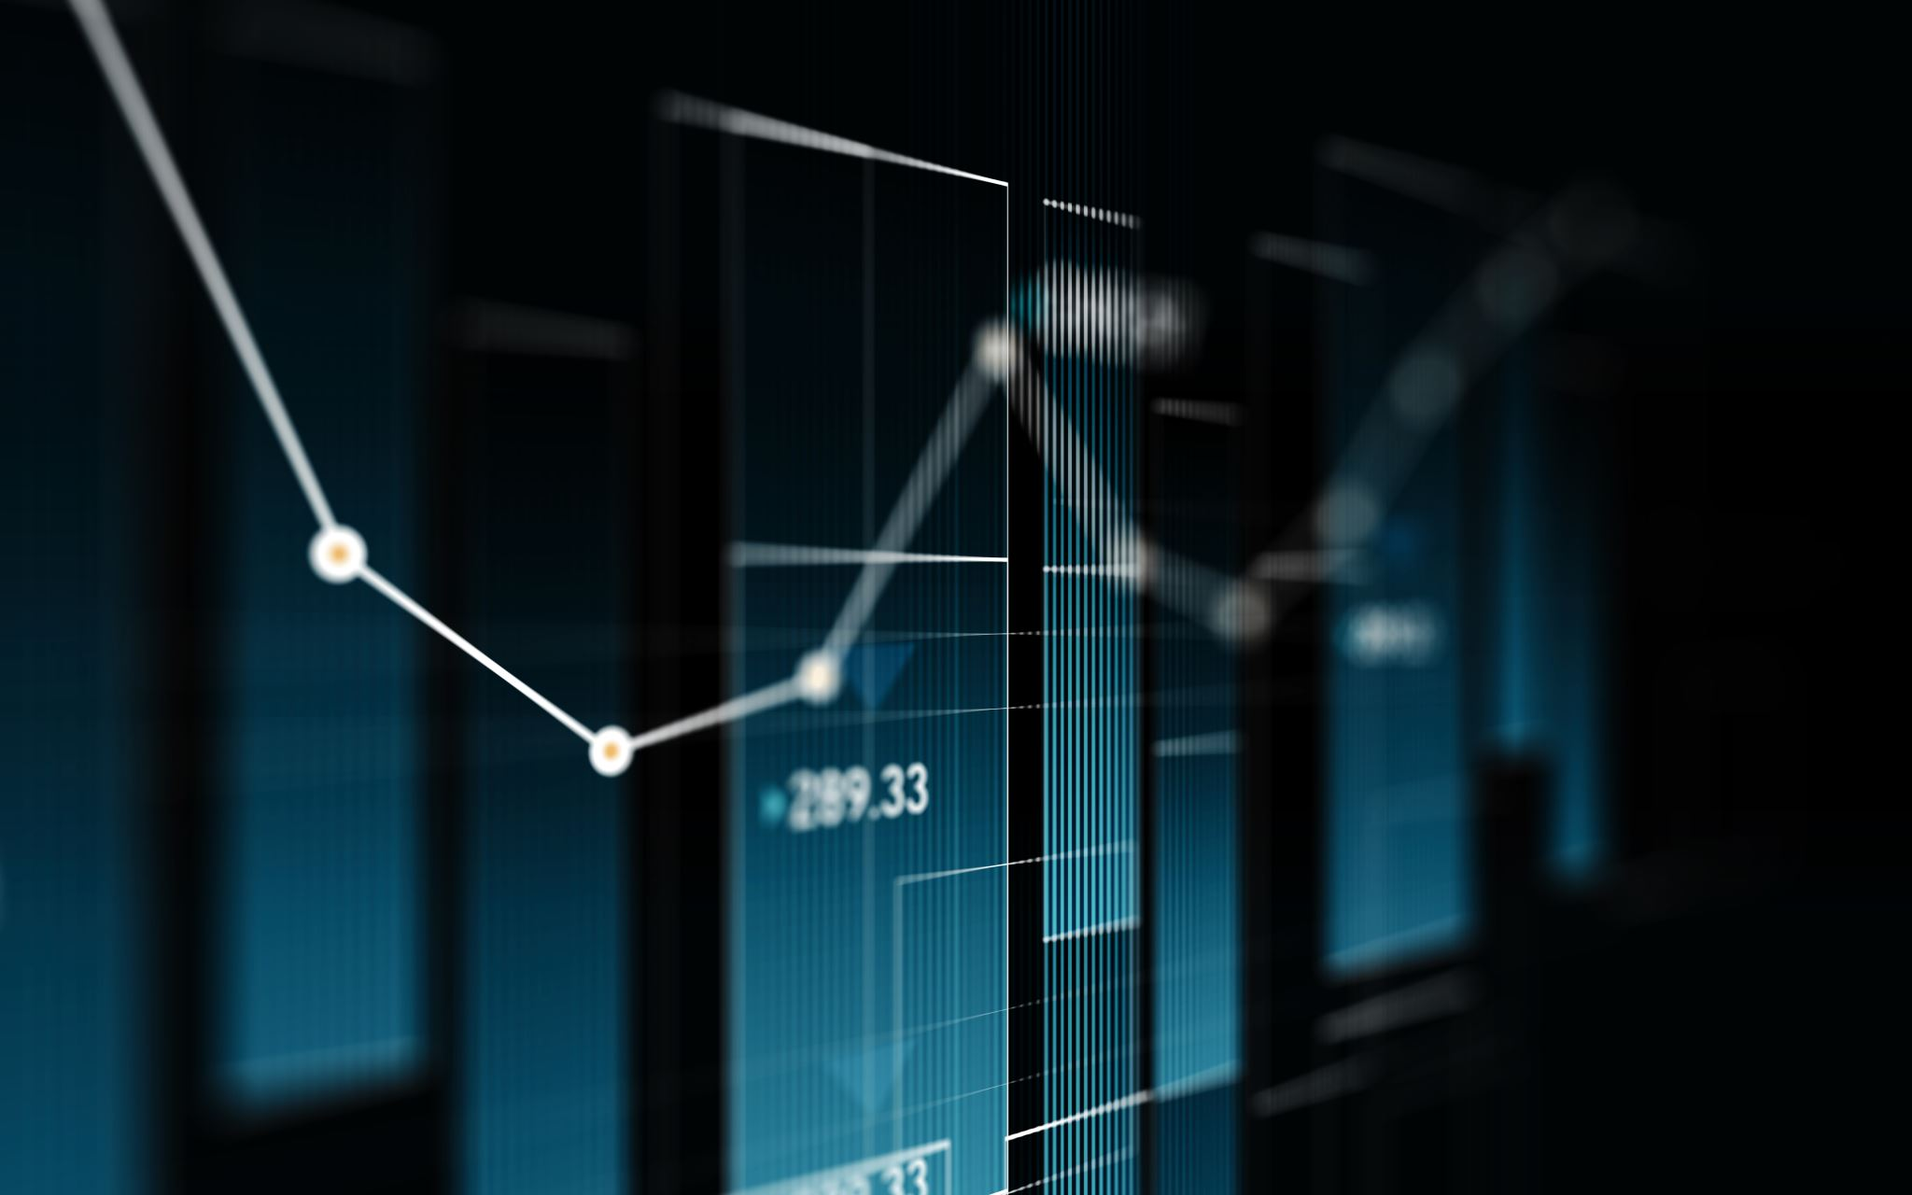
WORK PROGRESS
We have gone through different datasets ,in Kaggle and various other resources and downloaded the data set from a resource (Kaggle).here pre-process the dataset and remove unnesessary (empty )columns, we visualize the data in different form of graphs we implement our code in google-colab , we used different libraries like pandas for data analysis , time series, NUMPY for array computing in python and seaborn for statistical data visualization. Matplot lib for python ploting package.

Slide 10
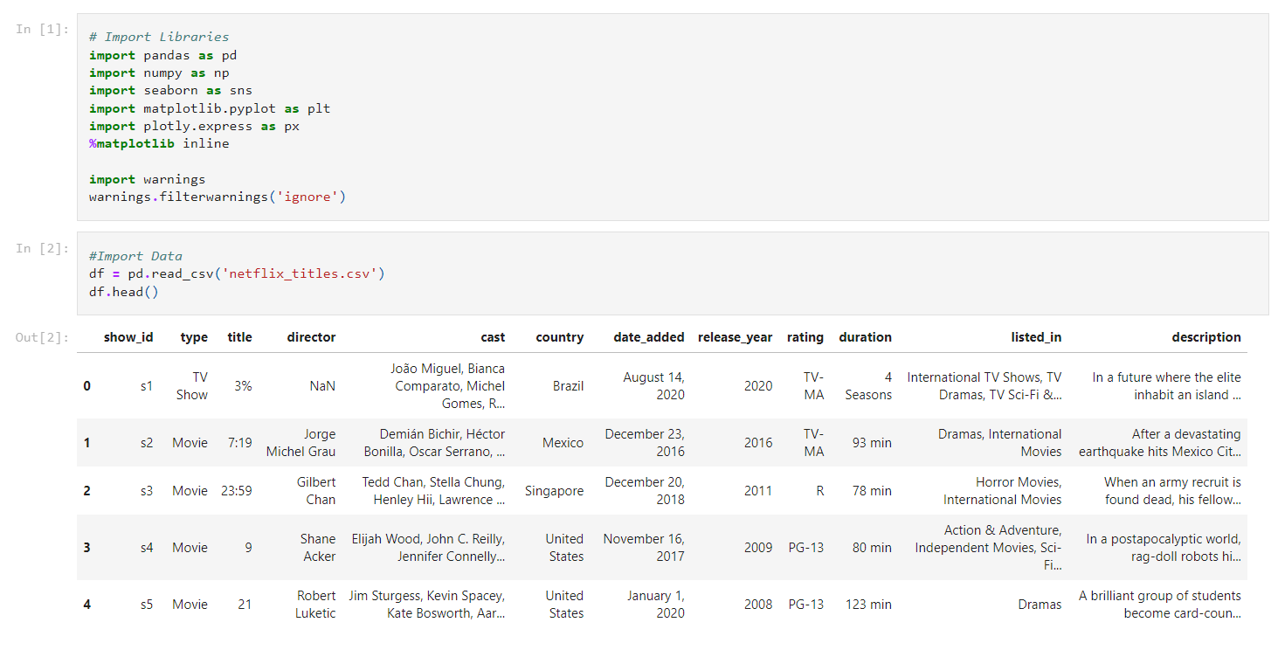
DATASET AND LIBRARIES

Slide 11
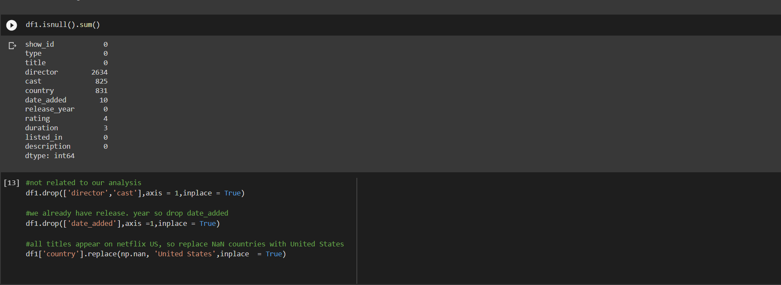
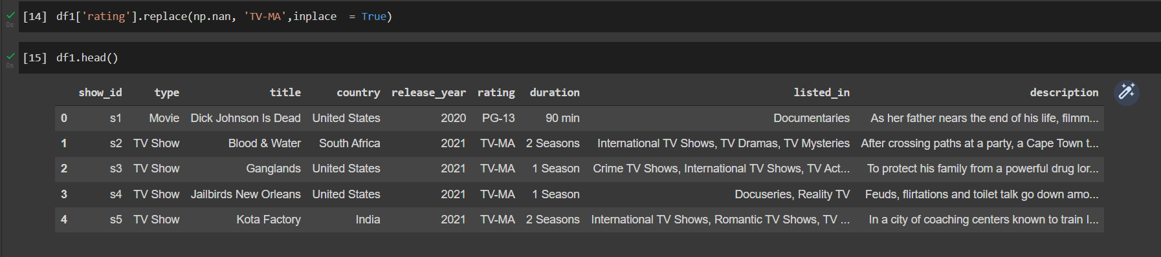
DATA PRE-PROCESSING AND CLEANING

Slide 12
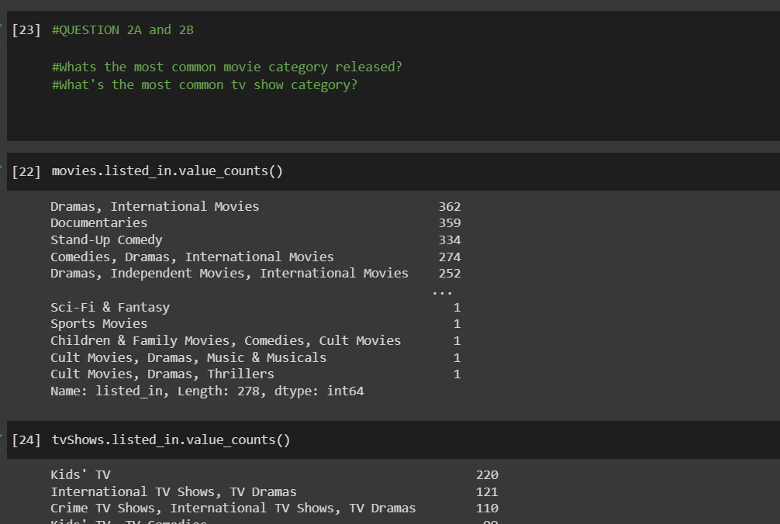
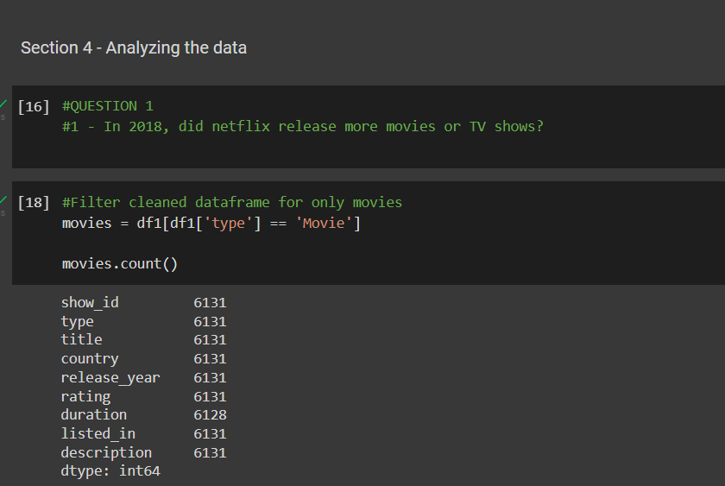
ANALYZING THE DATA

Slide 13
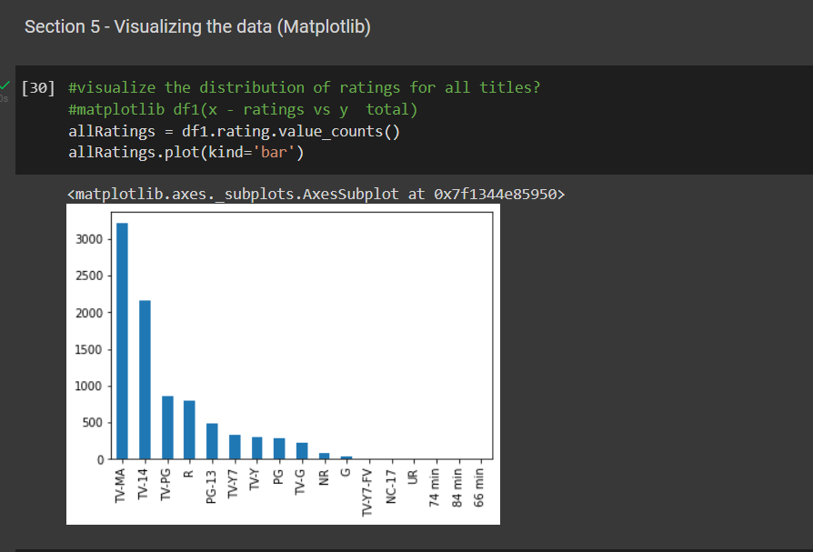
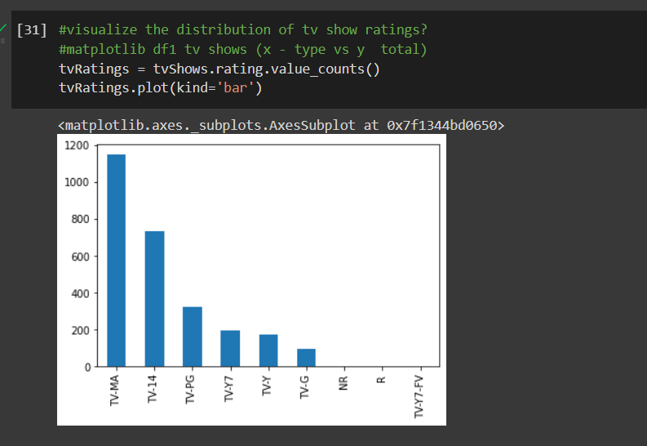
DATA VIZUALIZATION

Slide 14
ALPHA TESTING

Slide 15
REFERENCES
Exploratory and Sentiment Analysis of Netflix Data (researchgate.net)
https://www.researchgate.net/profile/Rajeswari-Nakka/publication/345710976_Offering_Recommendations_on_Netflix_dataset_by_Associations_among_Users_as_Trust_Metric/links/5fab71a0299bf18c5b64c0f1/Offering-Recommendations-on-Netflix-dataset-by-Associations-among-Users-as-Trust-Metric.pdf
https://pythonprogramming.net/graph-visualization-python3-pandas-data-analysis/?completed=/introduction-python3-pandas-data-analysis/
https://pandas.pydata.org/pandas-docs/stable/index.html

